Slide 1
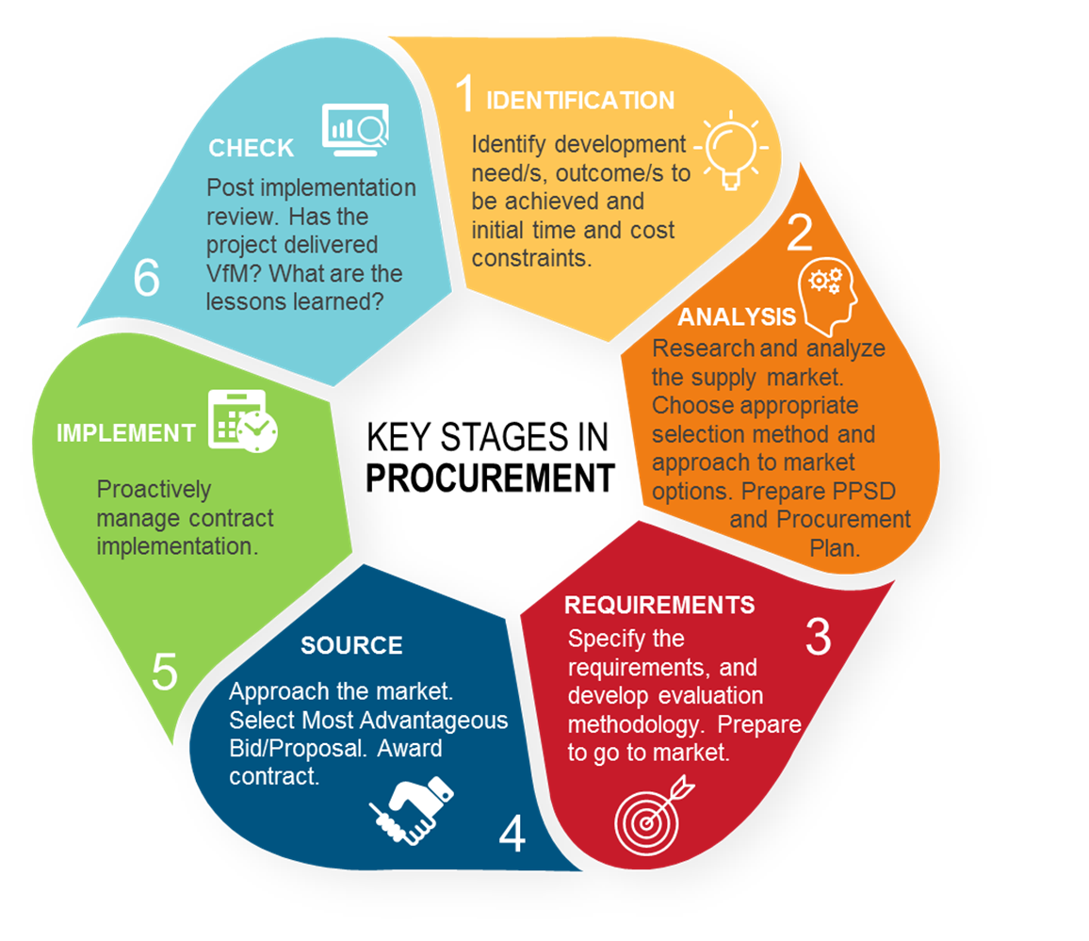

KEY STAGES IN PROCUREMENT and the new Procurement Framework
This diagram is a theoretical representation of the key stages in procurement. It shows the common stages and their usual sequencing. Actual procurements may differ.
The Procurement Process is defined in the Procurement Regulations as:
“the process that starts with the identification of need and continues through planning, preparation of specifications/ requirements, budget considerations, selection, contract award and contract management…”
This document supports good procurement practice. It is non-mandatory and provided as guidance only.

Slide 2
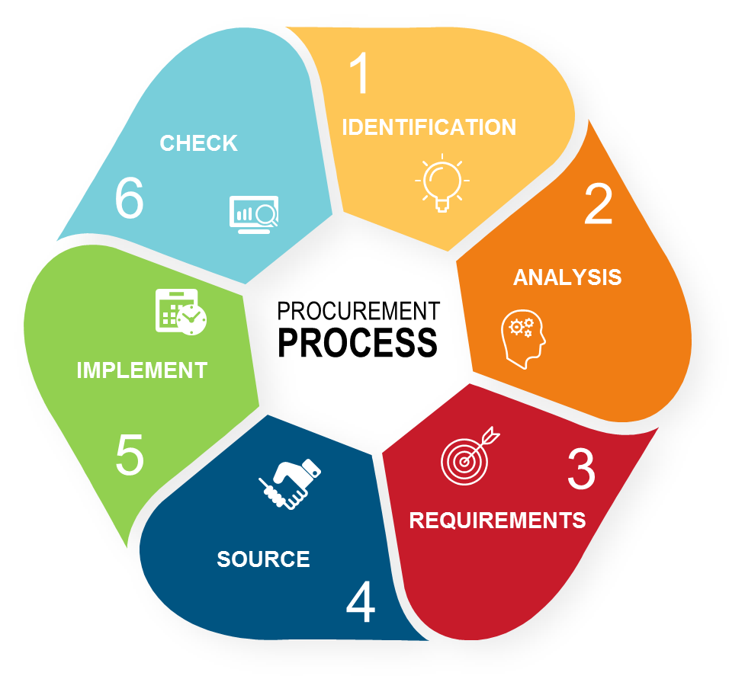
impact of the new Procurement Framework at the KEY STAGES IN PROCUREMENT
❶ OPERATIONAL CONSIDERATIONS
Emergency situations / small states / FCS
Hands on expanded implementation support (HEIS)
Alternative Procurement Arrangement
This annotated diagram indicates where changes (resulting from the new Procurement Framework) impact on the key stages in procurement.
It shows where the changes are most likely to happen. For some changes this can be at more than one stage.
Sustainability
❷ MARKET RESEARCH + PLANNING
❻ REVIEW
Project Procurement Strategy for Development (PPSD)
STEP monitoring + evaluation metrics
Public-private Partnership (PPP)
VfM + lessons learned (PPSD)
Alternative Procurement Arrangements (APAs)
Framework Agreement
Simplified national procurement requirements
Streamlined prior review
❺ CONTRACT IMPLEMENTATION
Sustainability
Contract management plan
STEP
KPIs (including VfM assessment)
❸ PROCESS DESIGN CONSIDERATIONS
Value engineering
2016 suite of SPDs
STEP
RFPs for GWNcS and Initial Selection
2 envelope process
Rated criteria
Value for money
❹ SOURCING PROCESS
Competitive Dialogue
E-procurement system
BAFO or Negotiations
Abnormally Low Bid/Proposal
Probity assurance
BAFO or Negotiation
Eligibility and participation of SOEs
Most Advantageous Bid/Proposal
E-procurement system
Notification of Intention to Award
International contract conditions (if no SPD contract conditions)
Standstill Period
STEP
Debriefs and complaints
Probity assurance
STEP

Slide 3

SUSTAINABILITY
at key stages in procurement
❶ INITIAL CONSIDERATIONS
Borrower’s sustainability policies, strategies and priorities
Community needs and expectations
Naturally arising environmental risks
Environmental and social impact assessments
❻ CHECK
Prioritization of sustainability needs
Assess sustainability outcomes and benefits achieved
Assess VfM over the whole-of-life
❷ MARKET RESEARCH + PLANNING
Review usefulness of sustainability KPIs
Review effectiveness of sustainability monitoring and reporting
What are the expected sustainability benefits?
Identify lessons learned
What relevant sustainable products/services are available in the market?
Share learning
Is the market able to deliver new or customized sustainable solutions?
What are the anticipated costs and what is the VfM proposition?
How will the procurement strategy address sustainability?
❺ CONTRACT IMPLEMENTATION
Develop Project Procurement Strategy for Development (PPSD)
Contract management plan
❸ PROCUREMENT PROCESS DESIGN
System to monitor delivery of sustainability priorities
RFQ, RFB or RFP Selection Method?
System to report against delivery and outcomes being achieved
Use Prequalification, or not?
Assess delivery against KPIs sustainability measures
Specifications: conformance or performance?
Value engineering to improve sustainability outcomes
Identify relevant sustainability standards and classifications
Assess sustainability priorities throughout the life-cycle
❹ SOURCING PROCESS
Develop sustainability criteria, including rated criteria and weightings, if applicable
Advertise the opportunity to attract interest from suitable vendors
Check contract terms reflect sustainability priorities, as appropriate
Evaluate bids/proposals
Assess quality of sustainable solutions
Asses bidder’s/proposer’s sustainability credentials and track records
Assess and compare whole-of-life costs
Evaluate VfM including quality and cost of sustainable solutions
Select the Most Advantageous Bid/Proposal
Agree Key Performance Indicators
Contract terms: bonus/penalty incentives and value engineering clause

Slide 4
ESHS CONSIDERATIONS
at key stages in procurement
❶ INITIAL CONSIDERATIONS
Procurement + Safeguards need to collaborate from the beginning
Need to develop an understanding of ESHS issues, risks and impacts at a country, regional and local level
Identify the range of risks a project of this size and scope could have at the proposed location
Consider community needs and expectations e.g. through impact assessments and social management plans
❻ CHECK
Identify the Borrower’s ESHS policies that will apply to the project or help the Borrower develop an ESHS policy
Assess sustainability outcomes and benefits achieved
Assess VfM over the whole-of-life
❷ MARKET RESEARCH + PLANNING
Review usefulness of sustainability KPIs
Review effectiveness of sustainability monitoring and reporting
What is needed to manage likely ESHS risks and impacts
Identify lessons learned
Consider ESHS needs when analyzing potential supply markets
Share learning
Check the market for best practice and new approaches to managing ESHS risks
What are the anticipated costs associated with ESHS risk management
What are the potential losses of failing to manage ESHS risks
❺ CONTRACT IMPLEMENTATION
Include ESHS considerations in the PPSD
Contract management plan
❸ PROCUREMENT PROCESS DESIGN
System to monitor delivery of sustainability priorities
RFQ, RFB or RFP Selection Method?
System to report against delivery and outcomes being achieved
Use Prequalification, or not?
Assess delivery against KPIs sustainability measures
Specifications: conformance or performance?
Value engineering to improve sustainability outcomes
Identify relevant sustainability standards and classifications
Assess sustainability priorities throughout the life-cycle
❹ SOURCING PROCESS
Develop sustainability criteria, including rated criteria and weightings, if applicable
Advertise the opportunity to attract interest from suitable vendors
Check contract terms reflect sustainability priorities, as appropriate
Evaluate bids/proposals
Assess quality of sustainable solutions
Asses bidder’s/proposer’s sustainability credentials and track records
Assess and compare whole-of-life costs
Evaluate VfM including quality and cost of sustainable solutions
Select the Most Advantageous Bid/Proposal
Agree Key Performance Indicators
Contract terms: bonus/penalty incentives and value engineering clause

